Slide 1
I. Integration of Superconducting NbN thin films with III-nitride semiconductors for Quantum Logic Applications 01/2018- today Nima Leclerc Dep. Materials Science and Engineering, Cornell University, Ithaca NY [work with Prof. Debdeep Jena] nl475@cornell.edu

Slide 2
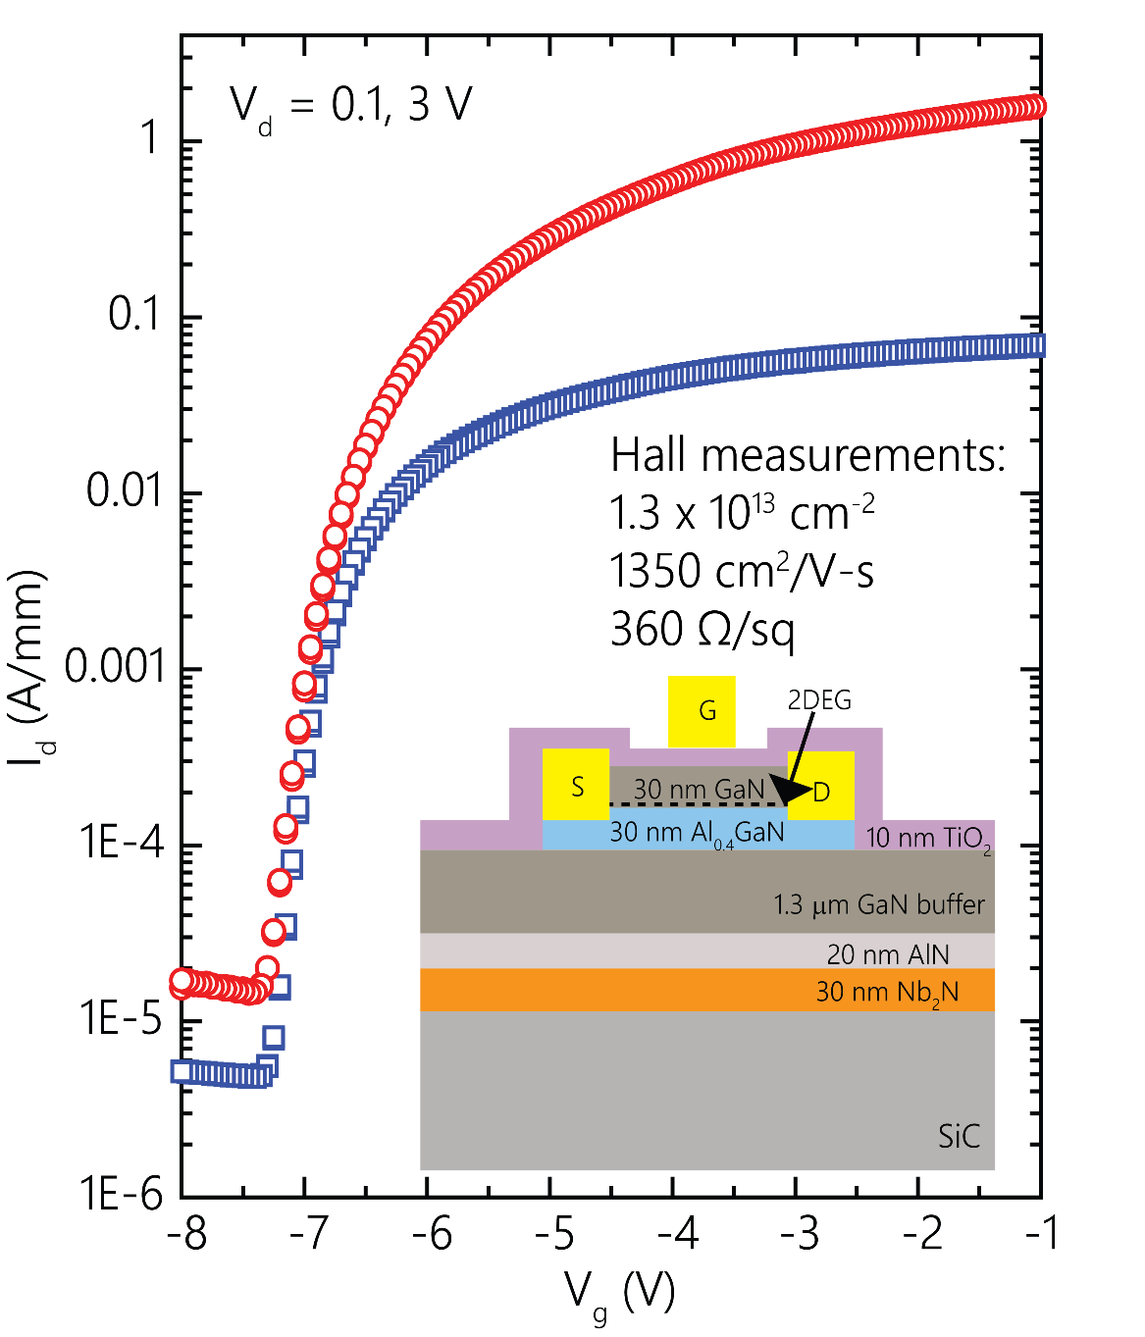
Nitride Superconducting Tunnel Junction Design
Goal: Fabricate scalable polarization induced Josephson Tunnel Junctions (JTJ) with nitride semiconductor barrier and NbN superconductors for RSFQ logic
(b)
Project revolves around realization of supercurrent flow in III-V semiconductor JTJ with NbN superconductor with my primary focus in prediction of new tunnel barrier materials (from GaN, ScN, GaN), phase-stability prediction at NbN-semi interface, transport property prediction, device design, and device/material characterization.
(a)
Skills Acquired in Device Design
n-contact
Decisions for photoresist, etch, geometry, and thicknesses needed for device fabrication
Hall/IV measurements of devices/samples
Decision on ideal stacking, material choices for interconnects, and substrate
SiO2
NbN
SiO2
GaN
(b) NbN HEMT device grown/fab in 02/18 by grad student John Wright ➔ performed characterization including IV/Hall prior to beginning work on tunnel devices)
NbN
SiC
(a) My proposed JTJ design ➔ particular focus in engineering thickness, structure, and roughness of barrier material (GaN) [plans to fab this month]

Slide 3
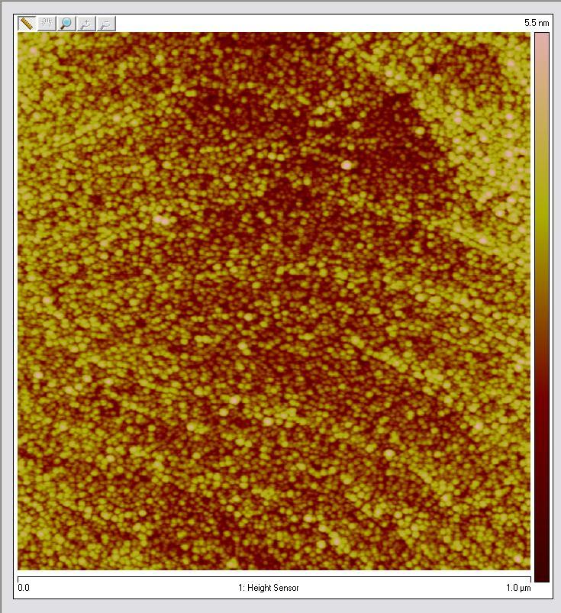
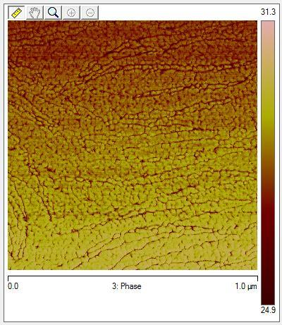
MBE Growth Parameters for Tunnel Barrier
My role in the growth process of super/semi interfaces with MBE entails optimizing growth parameters (flux, temperature, and time) to improve surface roughness and compare with transport characterization (IV) I perform ➔ growths executed by John Wright and my primary goal is to plan optimal growths
(a) Pre-anneal
Skills Acquired in Growth Engineering
(c)
Optimize pressure/temp to control material flux and desired phases
-Coordination with growers for anneal time to improve roughness
-Temp-dep transport measurement
(b) Post anneal 1150ºC
200W N2 Plasma
5 nm of GaN grown on 10 nm NbN prior to annealing at 1150 C (coordinated with John Wright to perform growth, I determined optimal Ga flux/stoichiometry with pressure and temperature.
Interface after annealing in 1150 C (I determined that it would be optimal to perform anneal between 1150-1500 C to minimize GaN surface roughness ➔ further characterization performed with AFM)
(c) Temperature dependent resistance measurements I performed to ensure that GaN/NbN junction annealing does not effect superconductor properties (want R=0 for T < 9.8 K)

Slide 4
Ab-initio Methodology in Junction Materials Design
My role in using ab-initio theory to predict new tunnel barrier materials entails using DFT/GW formalism to screen through candidate barrier materials w/crystal structure (lattice mismatch with NbN interface), electronic structure (w/in energy window of superconducting gap), predicting phase stability at interface (energetically favorable to alloy or phase separate at interface?), and predict transport characteristics (use DFT parameters to make real-space band diagrams and predict depletion width)
Skills Acquired in Growth Engineering
(1) Predict stability at interface by performing internal relaxations with Nb incorporation into semiconductor ➔ predict coordination number and formation energy of alloy with DFT
Use Quantum ESPRESSO/VASP/Berkeley GW packages to perform electronic structure calculations
-Write python scripts for post-processing data (i.e. pDOS, band strucutres)
-Develop transport models from DFT to understand cooper pair transport across barrier
(2) Predict formation enthalpies of Nb-GaN alloy formation with increased Nb content to predict phase separation and change in electronic structure w/DFT
(3) Screen for candidate barriers (GaN, ScN, AlN) of JTJ with DFT+GW and consider band alignment at interface ➔ desire material with superconducting gap in mid-gap of semiconductor (Fermi level in mid-gap)

Slide 5
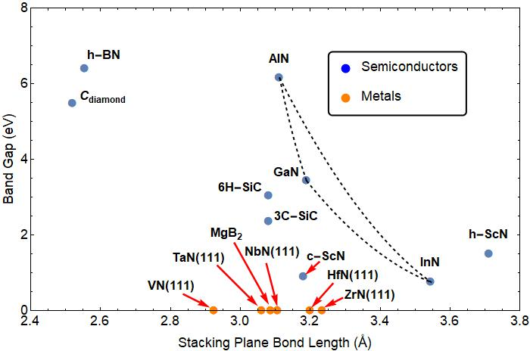
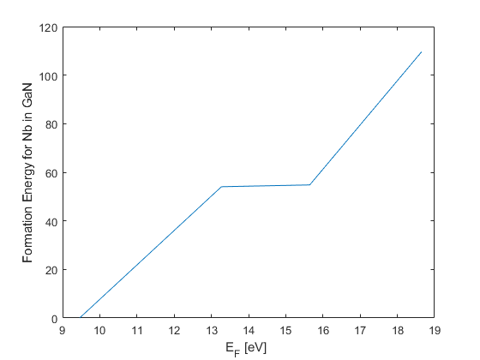
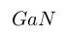
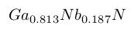
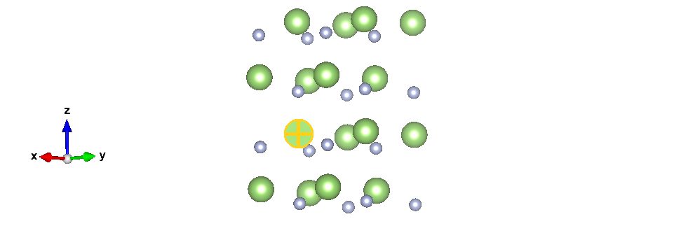
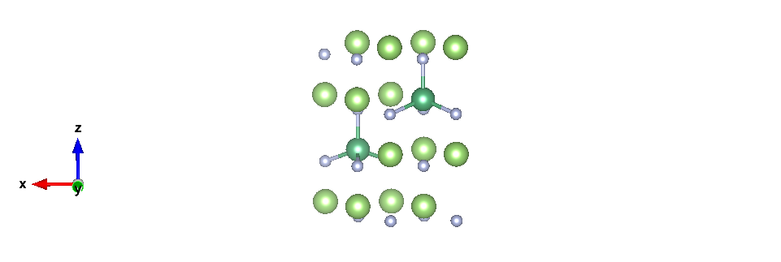
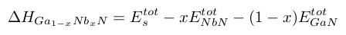
Interfacial Phase Stability of Semi-Super Junction
AlN [001]
Interface phase stability ➔ effect on tunneling?
NbN [111]
SiC
(c)
(d)
(a)
(b)
((a),(b)) I performed DFT relaxations of Nb incorporation in GaN to predict coordination (reveals tetrahedral coordination) w/N ➔ understand preference of Nb bonding at interface of N-polar GaN ➔ effects on electronic structure and tunneling from superconducting layer?
(c) Seek well lattice matched barrier material with NbN superconductor for [001]/[111] orientation given Wurtzite/Rocksal crystal structures of barreir/superconductor
(d) I computed formation enthalpies w/DFT given equation above to predict interface phase stability ➔prediction of thermodynamically unfavorable to form Nb-GaN alloy (phase separation favorable) ➔ agrees with TEM images and tunnel transport measurements of junction

Slide 6
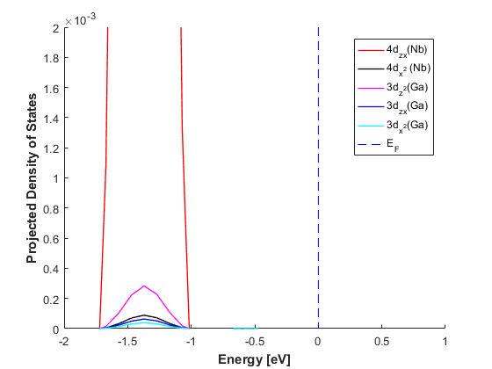
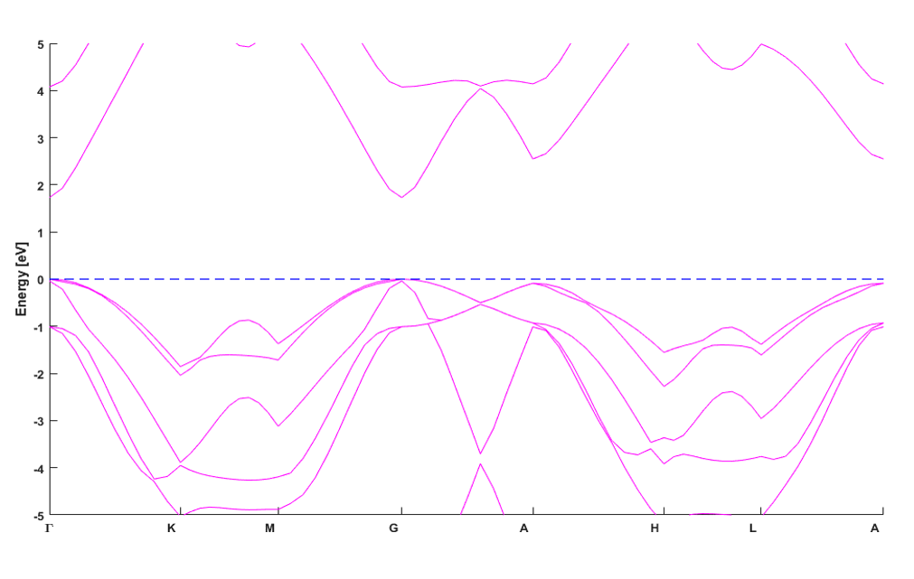
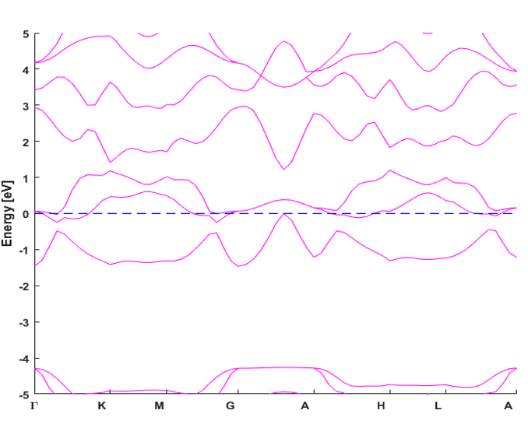
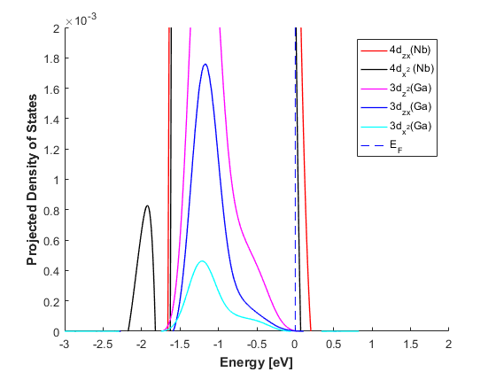
Effects of Nb-incorporation in GaN Barrier on Electronic-Structure
Seek to understand effects of Nb incorporation into GaN barrier material on electronic structure ➔ states still available for tunneling after incorporation and do we preserve electronic structure? This is important in understanding which unoccupied states cooper pairs from NbN can occupy at interface
(c) 6.25 % Nb incorporation
(a)
(b)
(d) 50 % Nb incorporation
(a/b) Band structures of GaN and Ga0.5Nb0.5N I computed with GGA+GW formalism ➔ reveals that semiconductor to metallic transformation, suggesting that at high Nb incorporation band gap closes and cooper pairs can resistively transport at interface ➔ have to consider SNS junction behavior and proximity effect
(c/d) Projected DOS I computed for 6.25/50 % Nb incorporation in GaN interface ➔ d states for tunneling available at low incorporation and resistive transport and high incorporation

Slide 7
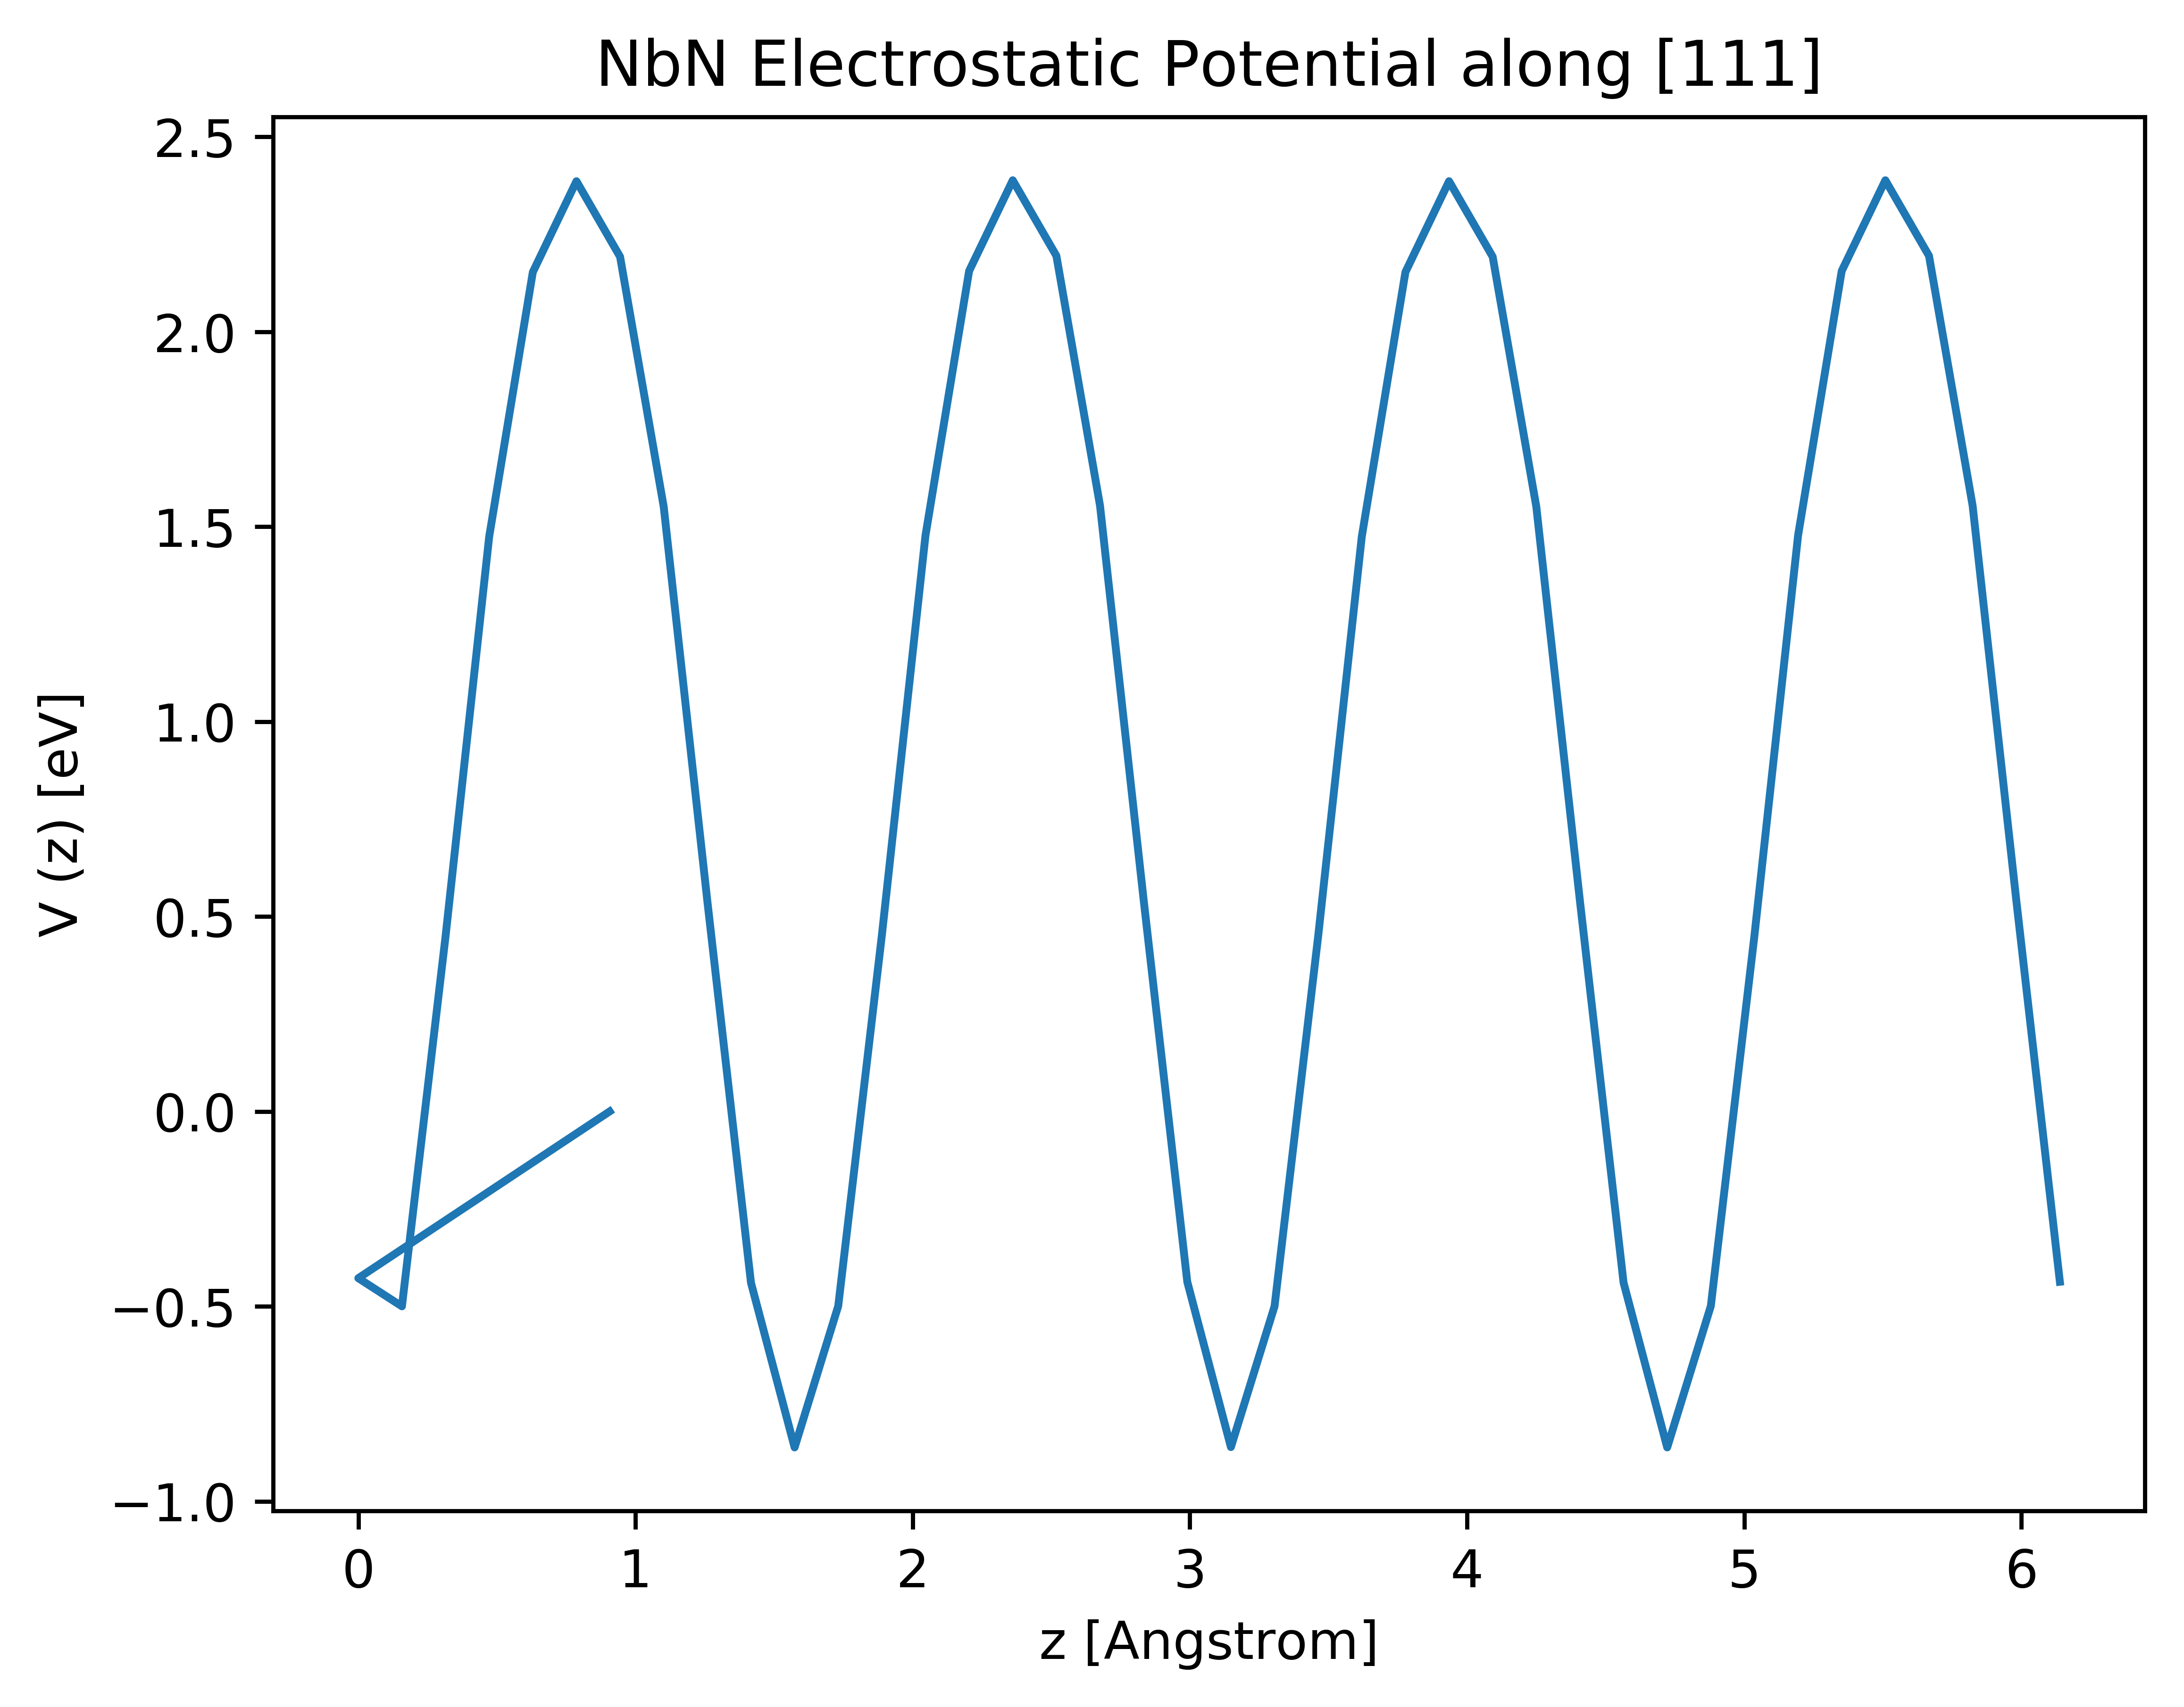
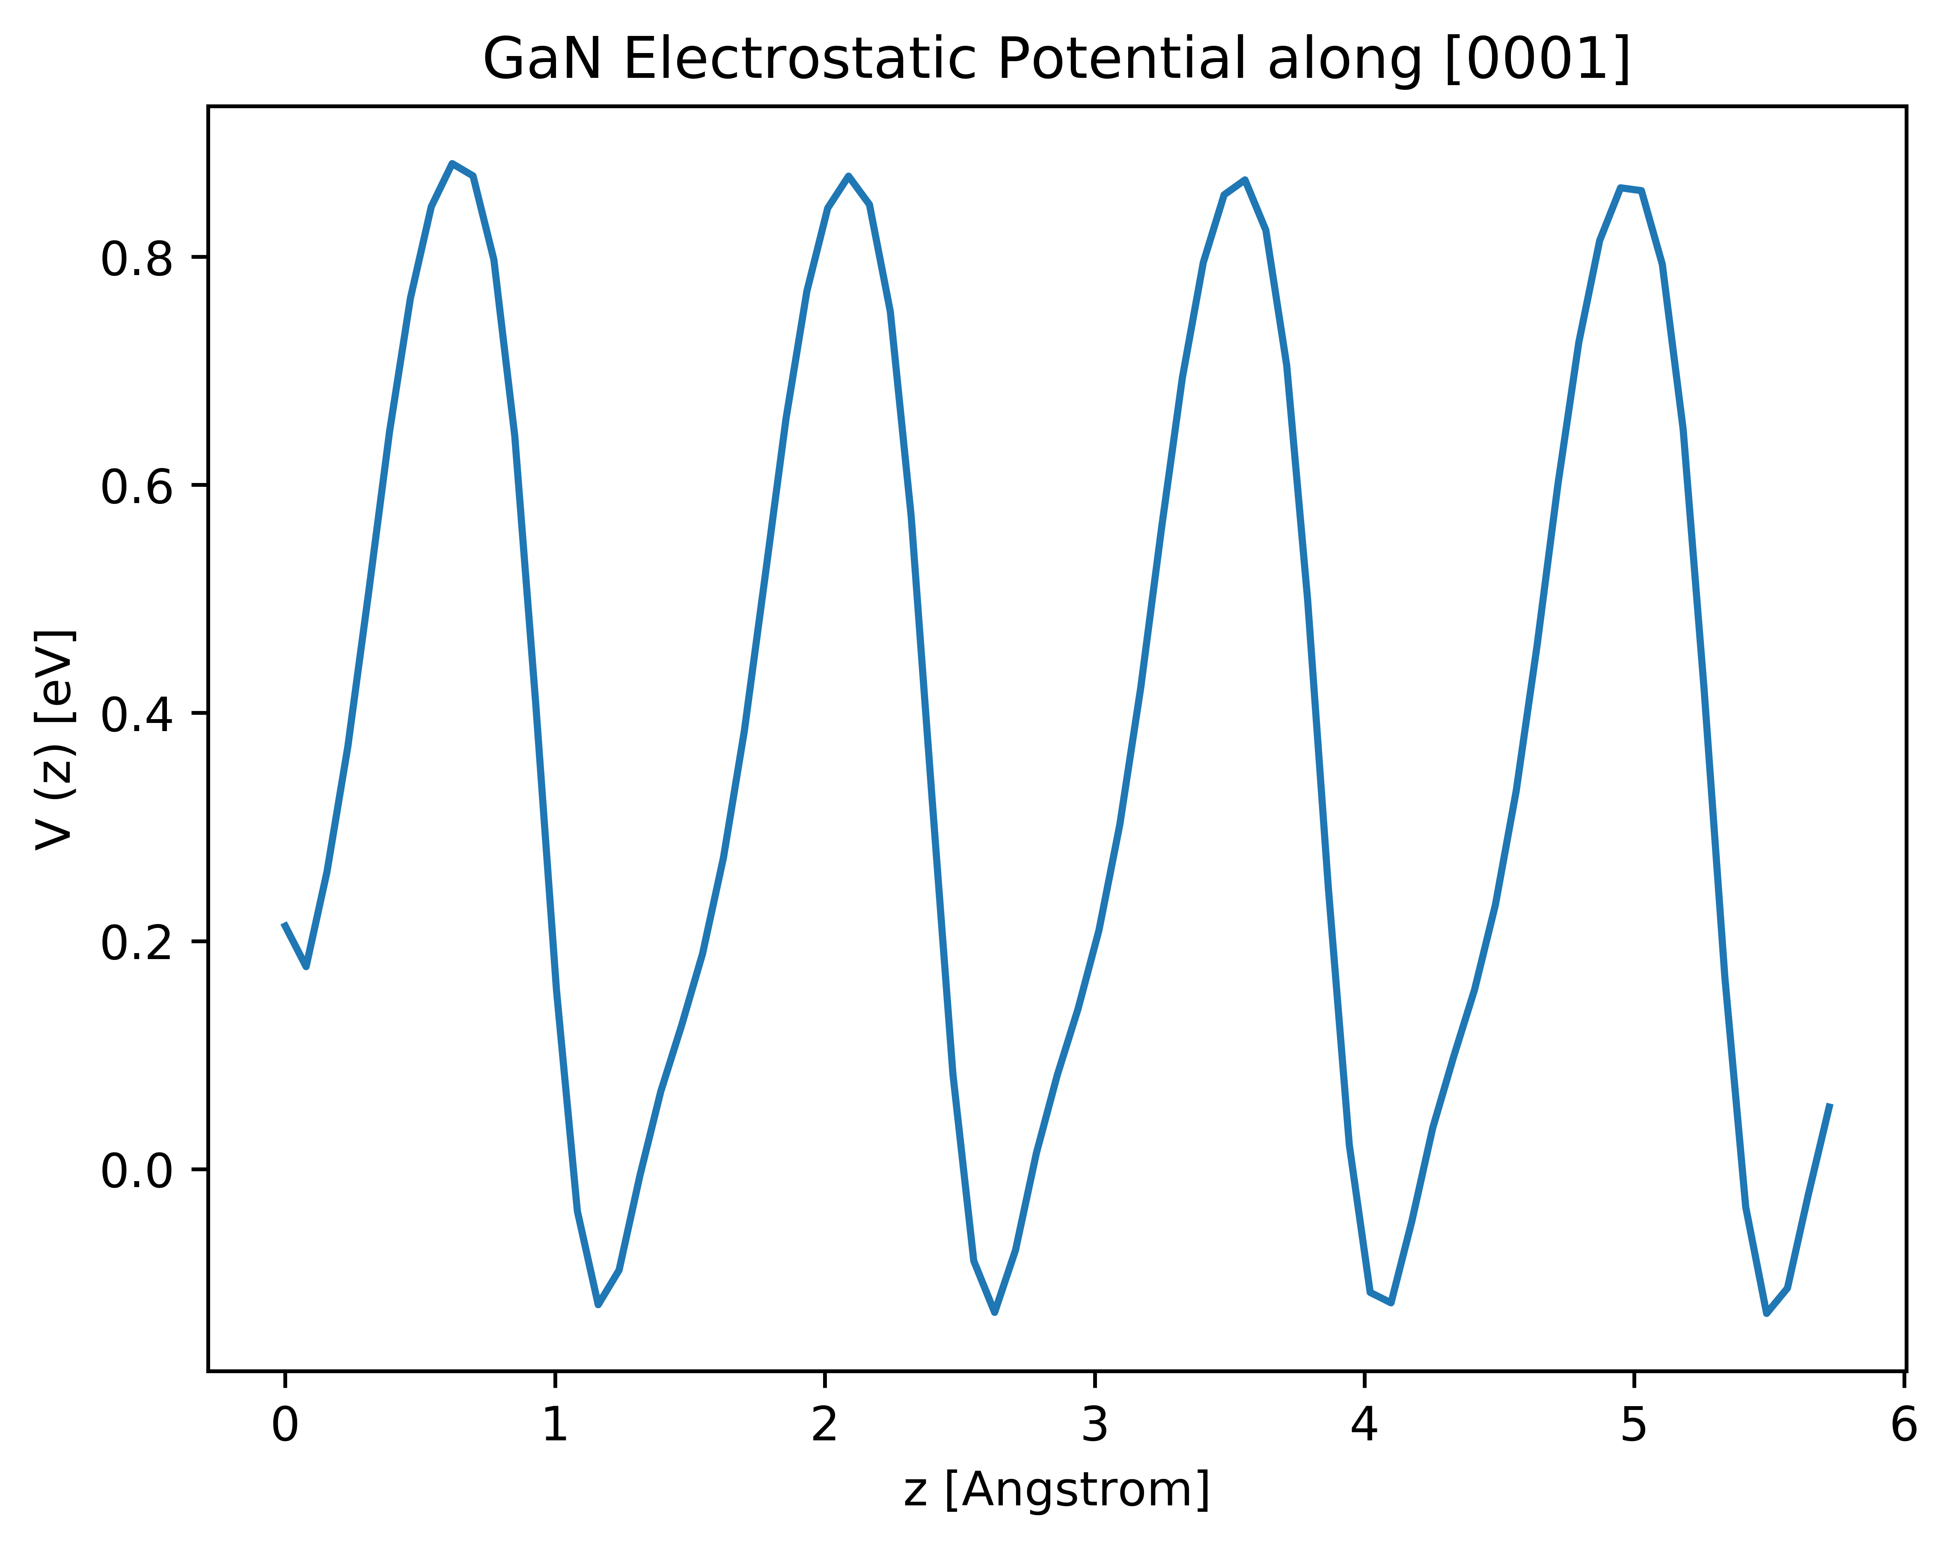
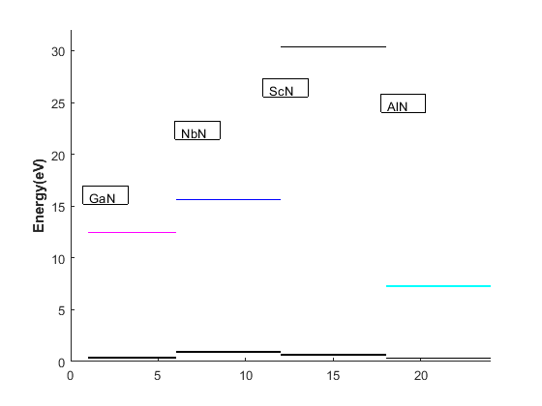
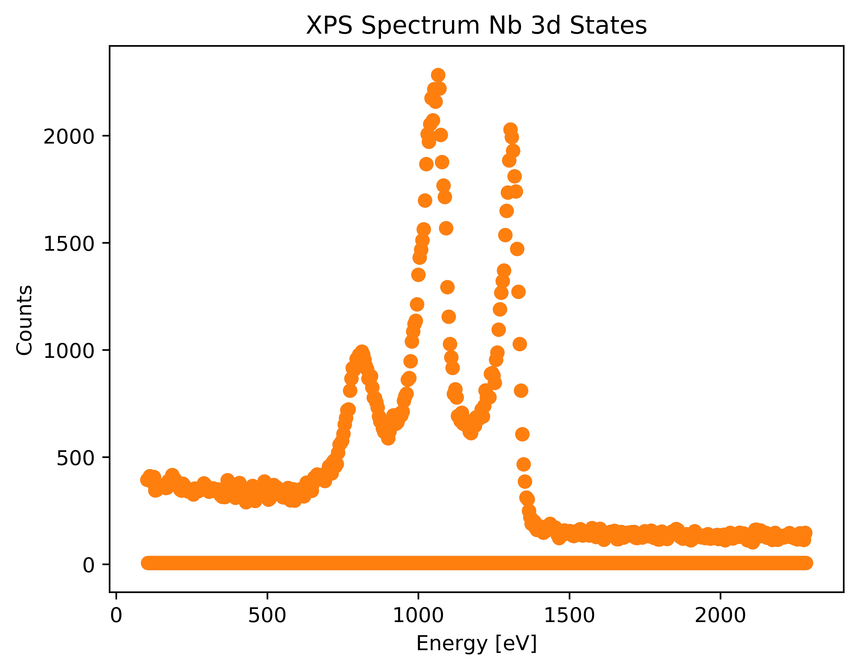
Screening for Barrier Materials from Electronic Structure
In screening for new barrier materials, I decided that it is important to consider only materials with energy gaps within the energy window of the NbN superconducting gap ➔ Candidate barrier materials include ScN (rocksalt), AlN, and GaN (wurtzite). Band alignments for GaN/NbN interface then compared with experimental XPS values
(a)
(b)
(c)
(d)
(a/b) Average electrostatic potential for each material of heterostructure (NbN/GaN) computed along growth direction as reference for band alignment ➔ VBM computed with GGA+GW ➔ (c) band alignment calculation with ScN, AlN, GaN, NbN and predicts that for all materials except ScN, superconducting gap is within material band gap (Type I alignment) and cooper pairs flow from NbN to Sm. ➔ crucial for material barrier selection
(d) Initial XPS measurements I have performed on 3nm NbN on GaN heterostrucutre to experimentally predict band alignment of heterostructure ➔ compute shift in peak energies of Nb 3d states between heterosturcture and bulk material ➔ provide insight on interfacial bonding

Slide 8
Next Steps in Project I
-Predict effects of electron-phonon coupling at interface on tunneling transport
-Develop model to predict IV characteristic of barrier with Bogouliobov transport model from first principles energy alignments
-Theoretically predict effects of interfacial polarization on NbN Tc and cooper pair tunneling transport
-Perform XPS measurements on heterostructure of various barrier thicknesses
-Fabricate JTJ devices with various barrier thicknesses and explore new candidate materials
-Explore growth/fabrication of NbN with GaN superconducting LED device

